Slide 1
Day 6
Conditional and Switch statements, Loops

Slide 2
If, else, else if, switch
Remember the logical operators we discussed? This is where they are majorly used.
C++ has the following conditional statements:
Use if to specify a block of code to be executed, if a specified condition is true
Use else to specify a block of code to be executed, if the same condition is false
Use else if to specify a new condition to test, if the first condition is false
Use switch to specify many alternative blocks of code to be executed

Slide 3
Loops
There may be a situation, when you need to execute a block of code several number of times. In general, statements are executed sequentially: The first statement in a function is executed first, followed by the second, and so on.
Programming languages provide various control structures that allow for more complicated execution paths.
A loop statement allows us to execute a statement or group of statements multiple times and following is the general from of a loop statement in most of the programming languages −

Slide 4
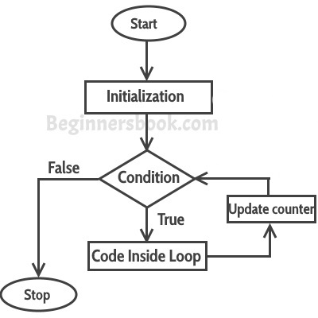
Loops

Slide 5
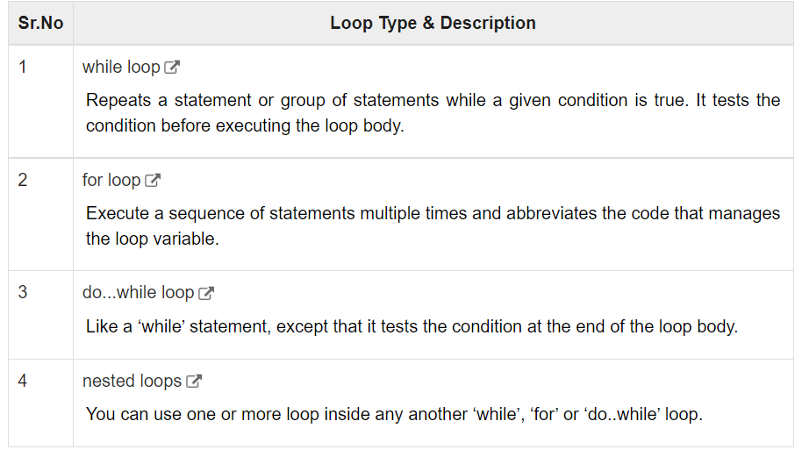
Types of Loops
C++ programming language provides the following type of loops to handle looping requirements.

Slide 6
While loop
A while loop statement repeatedly executes a target statement as long as a given condition is true.
The syntax of a while loop in C++ is −
while(condition) {
statement(s);
}
Here, statement(s) may be a single statement or a block of statements. The condition may be any expression, and true is any non-zero value. The loop iterates while the condition is true.

Slide 7
For loop
A for loop is a repetition control structure that allows you to efficiently write a loop that needs to execute a specific number of times.
The syntax of a for loop in C++ is −
for ( init; condition; increment ) {
statement(s);
}

Slide 8
For loop
Here is the flow of control in a for loop −
The init step is executed first, and only once. This step allows you to declare and initialize any loop control variables. You are not required to put a statement here, as long as a semicolon appears.
Next, the condition is evaluated. If it is true, the body of the loop is executed. If it is false, the body of the loop does not execute and flow of control jumps to the next statement just after the for loop.
After the body of the for loop executes, the flow of control jumps back up to the increment statement. This statement can be left blank, as long as a semicolon appears after the condition.
The condition is now evaluated again. If it is true, the loop executes and the process repeats itself (body of loop, then increment step, and then again condition). After the condition becomes false, the for loop terminates.

Slide 9
Do...while loop
Unlike for and while loops, which test the loop condition at the top of the loop, the do...while loop checks its condition at the bottom of the loop.
A do...while loop is similar to a while loop, except that a do...while loop is guaranteed to execute at least one time.
The syntax of a do...while loop in C++ is −
do {
statement(s);
}
while( condition );

